Slide 1
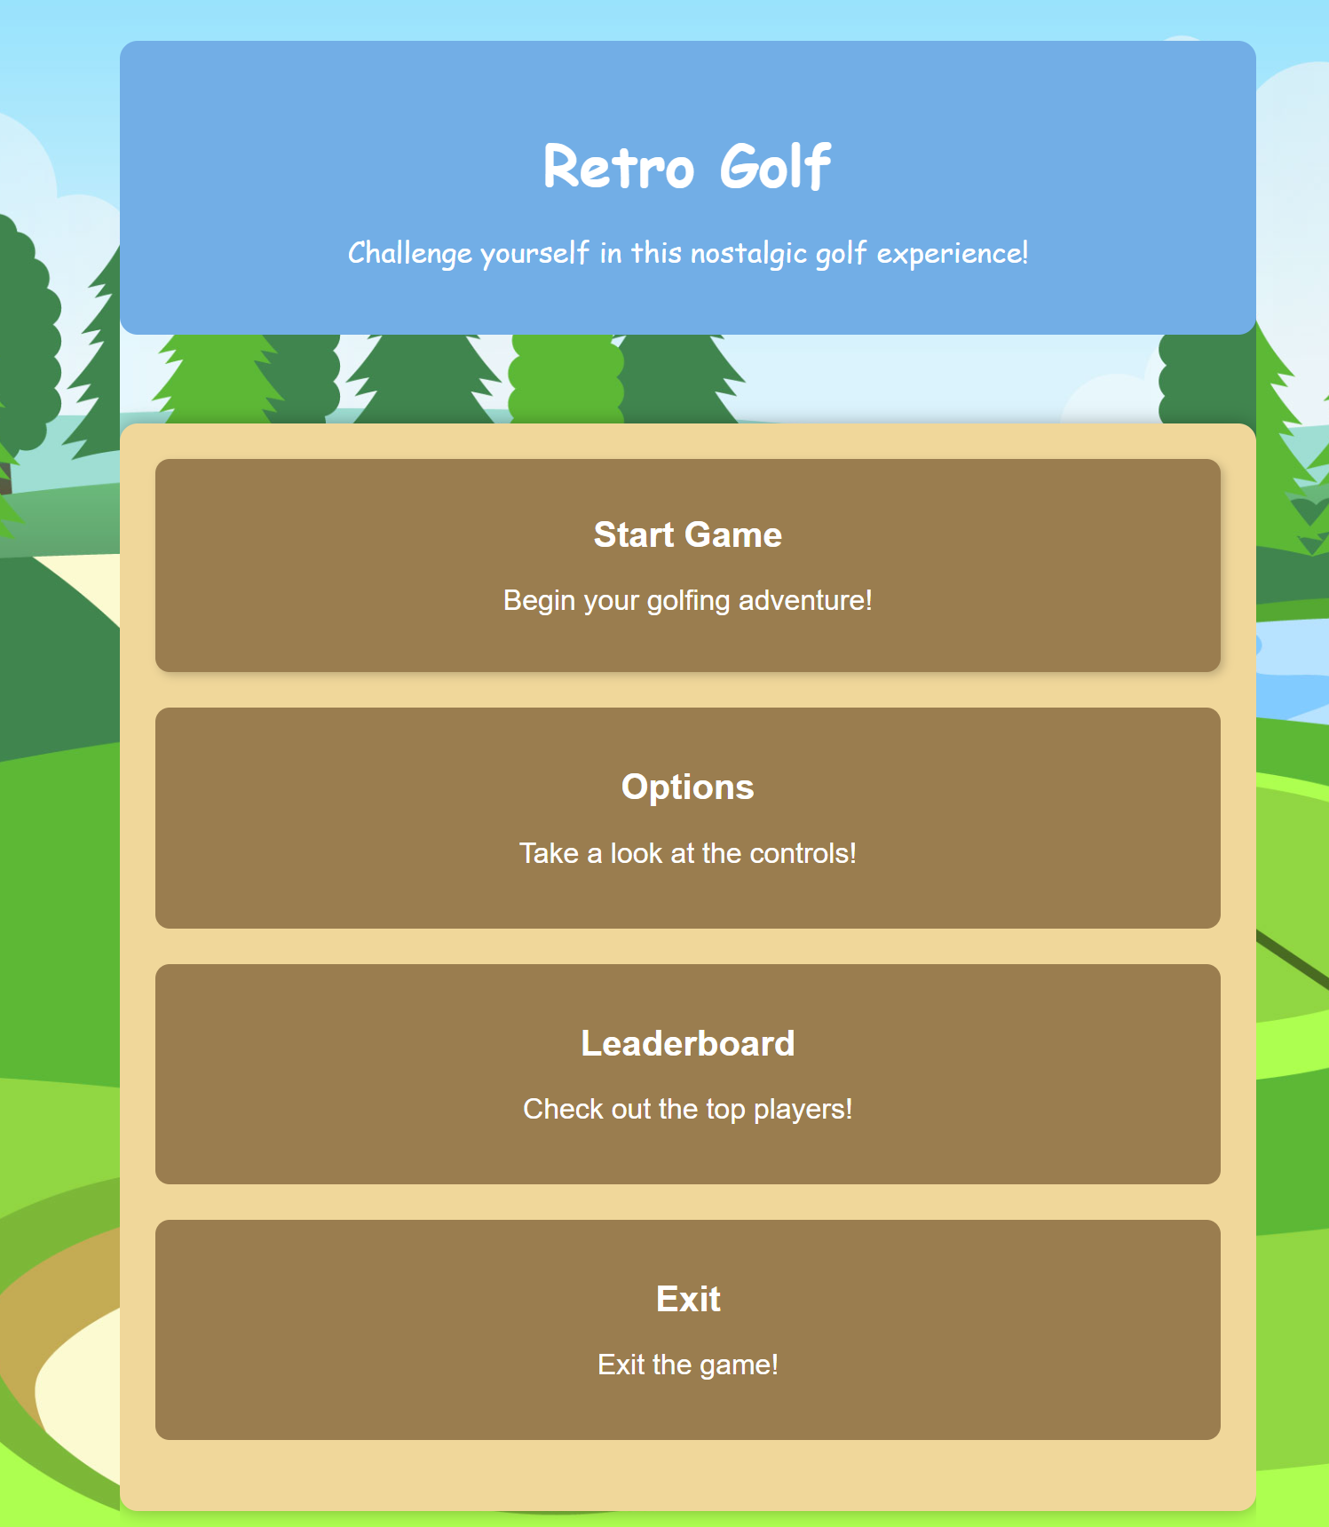
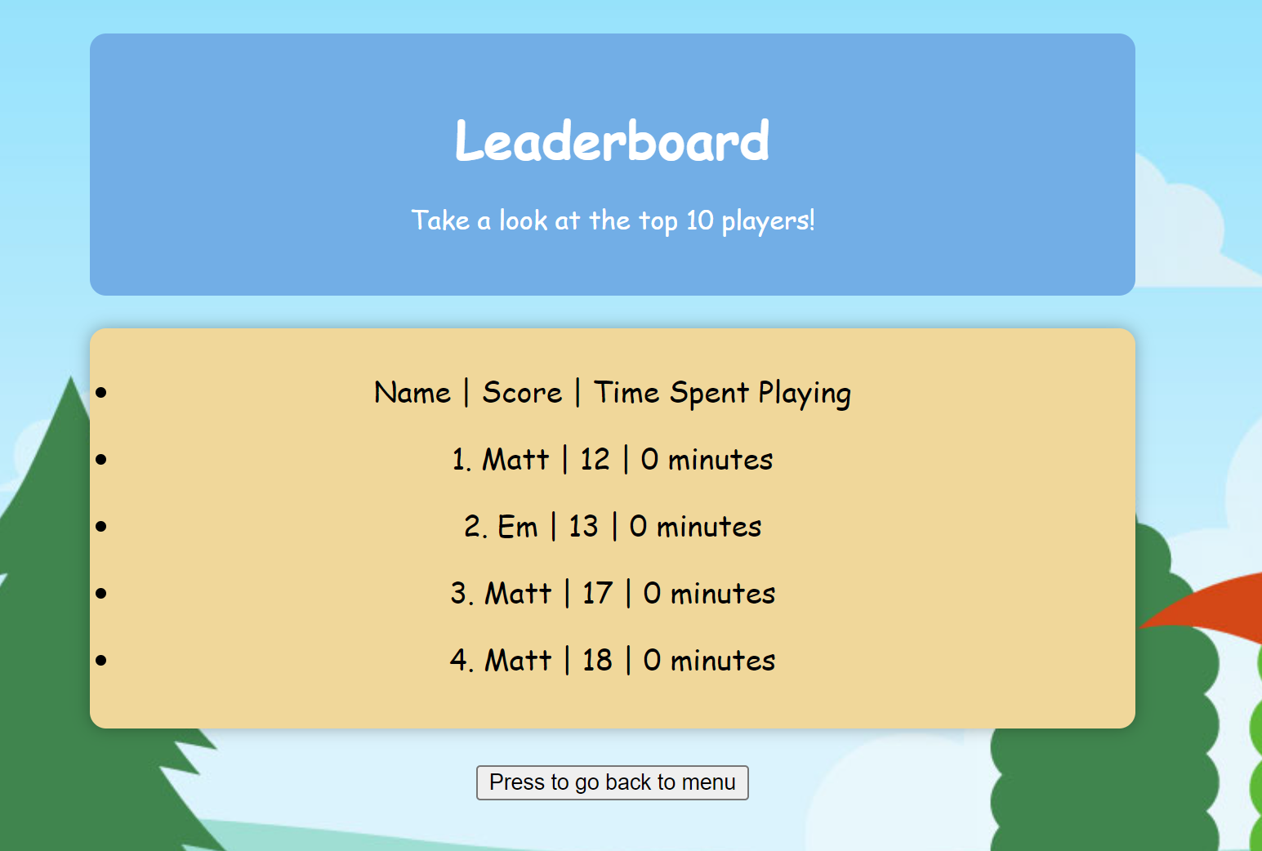
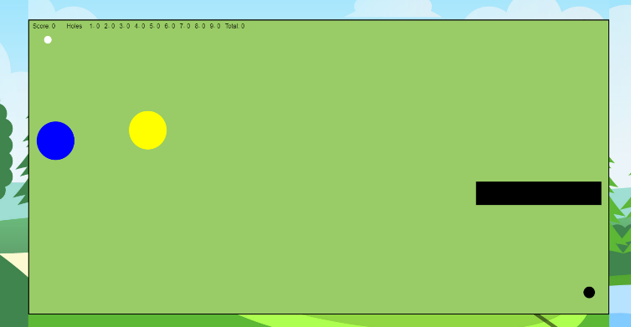

Retro Golf
Tee off into nostalgia!
Future Development
Game Overview
Core Features
Step into the nostalgic world of Retro Golf, where classic gameplay meets golf.
Classic Aesthetics, Modern Gameplay: Enjoy the Nostalgia of retro graphics whilst experiencing smooth gameplay.
Ball Dragging Mechanics: Experience intuitive controls with a unique ball-dragging mechanic, allowing players to precisely aim their shots and adjust power with ease.
Randomly Placed Obstacles: Navigate through sand, water and wall hazards randomly placed across each hole, ensuring a fresh and unpredictable challenge.
Customize Ball Colour: Personalize your gameplay experience by choosing from a range of colours, adding a touch of customization to your rounds.
Integrated Leaderboard: Keep track of your minutes spent playing and compare your scores against friends. Input your name to see your scores displayed amongst the top players!
Immersive Sound Effects: Immerse yourself in a golf atmosphere with nature inspired sound effects. Hear the satisfying thud of the golf ball as its struck, adding authenticity to your golfing experience.
Dynamic Weather Effects: From rain showers to gusty winds, each weather condition will add a new layer of challenge to your golfing adventure.
Daily Challenges: Stay engaged with Retro Golf’s daily challenges, offering new objectives and rewards every day.
Power ups: Discover power-ups scattered throughout Retro Golf’s courses. Collect these to gain powerful advantages.
Retro Golf invites players to embark on a nostalgic journey through 9 unique and exciting holes of golf.
With an integrated leaderboard, players can track their progress and compete against other players to gather the lowest scores and secure the top spot.
Master the easy-to-learn controls of the game and avoid obstacles to become the Retro Golf Champion!
Inspiration for this game has come from classics like Raft Wars and 8 Ball Pool.
Success Stories
“As a fan of arcade games, I really enjoy playing Retro Golf. The ball dragging mechanic is unique and I love the randomly placed obstacles that keep each round exciting and unpredictable.” – Beth
“The leaderboard makes Retro Golf a fun competition for me and my friends. I like the added detail of being able to change the ball colour. – Emily
Matthew Fish
Matthew.Fish@students.plymouth.ac.uk
BSc(hons) Computer Science 2024

